Slide 1
Modelling 2D soft bodies as spring-mass systems using Newtonian mechanics
PHY 380 - Introduction to Computational Physics
Yashab Yadav

Slide 2
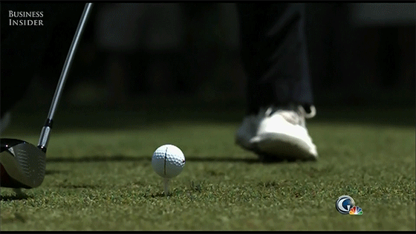
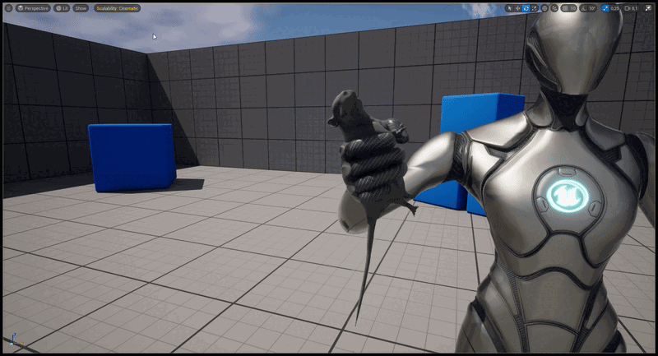
Soft Body Simulations
Anything that can restore its initial shape after a slight deformation is a soft body
=> every solid is a “soft” body to some extent.
https://www.the42.ie/tiger-woods-slo-mo-gif-953467-Jun2013/
Soft body dynamics have applications in:
Physics simulations
Structural engineering
Video game development
https://www.artstation.com/blogs/canberkyucekok/agpWE/quick-tutorial-01-how-to-physically-simulate-soft-body-attachments-in-unreal-engines

Slide 3
Initial motivation:
Dynamics of biological cells can be investigated using various types of molecular dynamics simulation.
In these simulations, cells and/or it’s constituents can be modelled as hard spheres, polymers etc. depending on the type of problem.
Some models are better approximated using soft bodies.
I plan to explore how soft body can help build better models for cell dynamics during my research.
Other motivations:
Practice writing scalable and easy to read code by implementing concepts of OOP.
Initial goals:
Implementation of spring mass soft body
Soft body using finite element analysis and comparison of compute performance with spring mass for different systems
3D soft bodies
Collision of soft bodies with rigid obstacles
Interactive drawing frame for analysis
Parallelization for compute boost

Slide 4
Initial motivation:
Dynamics of biological cells can be investigated using various types of molecular dynamics simulation.
In these simulations, cells and/or it’s constituents can be modelled as hard spheres, polymers etc. depending on the type of problem.
Some models are better approximated using soft bodies.
I plan to explore how soft body can help build better models for cell dynamics during my research.
Other motivations:
Practice writing scalable and easy to read code by implementing concepts of OOP.
Initial goals:
Goals achieved:
Implementation of spring mass soft body
Soft body using finite element analysis and comparison of compute performance with spring mass for different systems
3D soft bodies
Collision of soft bodies with rigid obstacles
Interactive drawing frame for analysis
Parallelization for compute boost
Implementation of spring mass soft body

Slide 5
Initial motivation:
Dynamics of biological cells can be investigated using various types of molecular dynamics simulation.
In these simulations, cells and/or it’s constituents can be modelled as hard spheres, polymers etc. depending on the type of problem.
Some models are better approximated using soft bodies.
I plan to explore how soft body can help build better models for cell dynamics during my research.
Other motivations:
Practice writing scalable and easy to read code by implementing concepts of OOP.
Initial goals:
Goals achieved:
Implementation of spring mass soft body
Soft body using finite element analysis and comparison of compute performance with spring mass for different systems
3D soft bodies
Collision of soft bodies with rigid obstacles
Interactive drawing frame for analysis
Parallelization for compute boost
Implementation of spring mass soft body (partially complete)

Slide 6
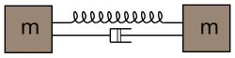
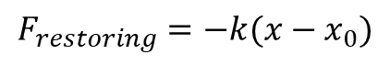

Spring Mass models of soft bodies
https://en.wikipedia.org/wiki/Soft-body_dynamics
Masses connected with springs obeying Hooke's law:
Damping based on the relative velocity of the connected springs w.r.t each other:
$$F_{restoring}=−k(x−x_{0})$$
$$F_{damp}=−bv_{rel}$$

Slide 7
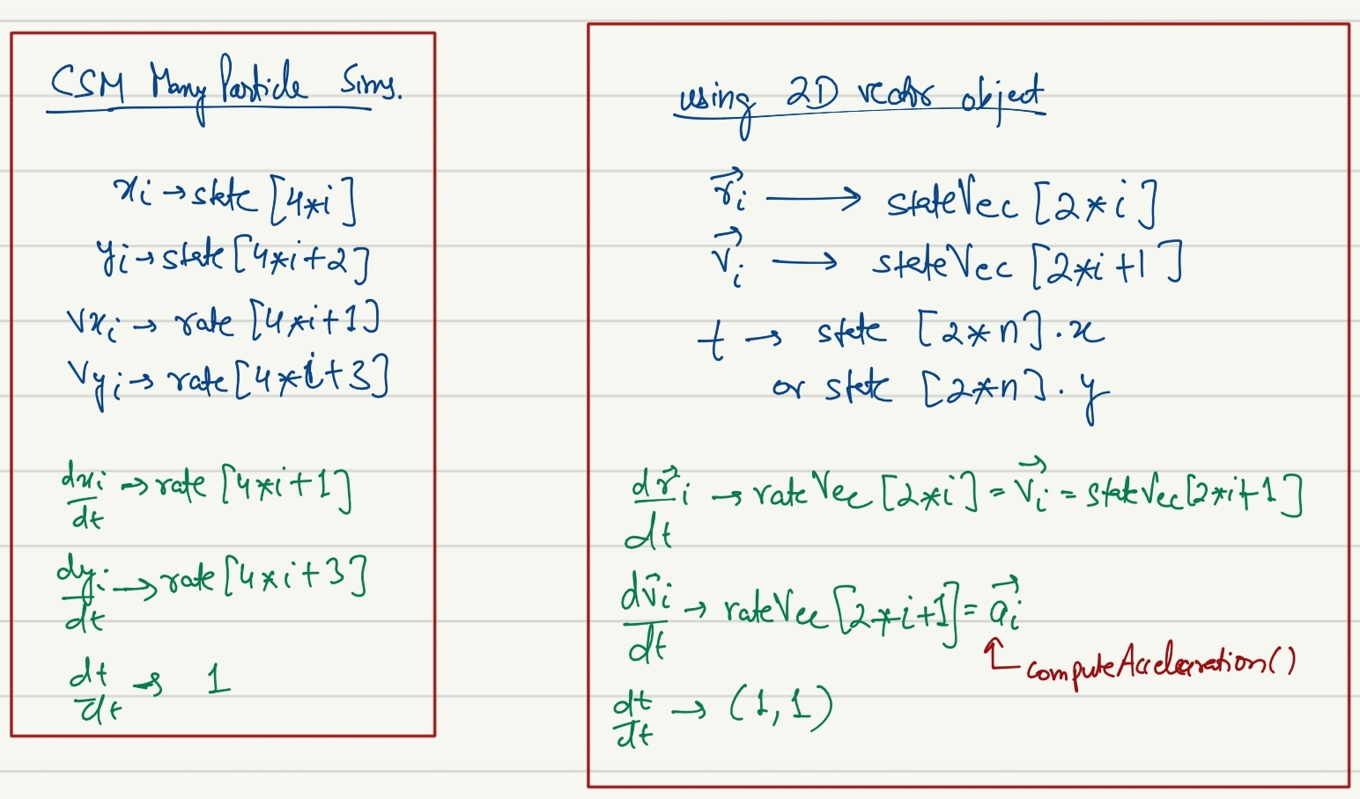
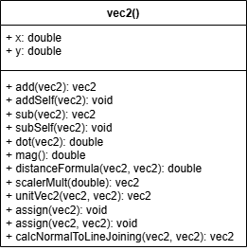
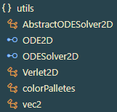
A quick note about vectors:
A 2D vector class vec2 to directly use the vectors rather than each individual component separately in the code.
Had to rewrite some abstract classes and interfaces to solve differential equations of vec2 objects.

Slide 8
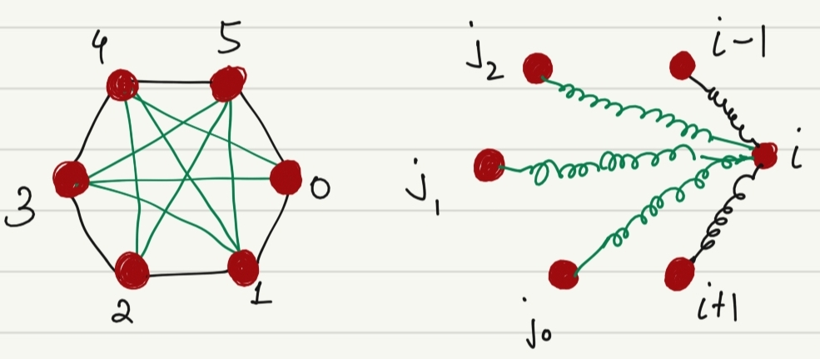
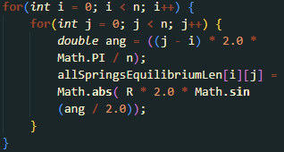
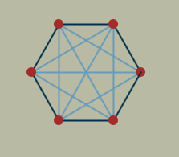
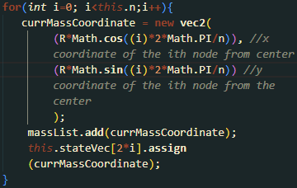
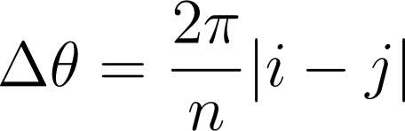
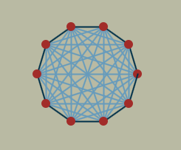
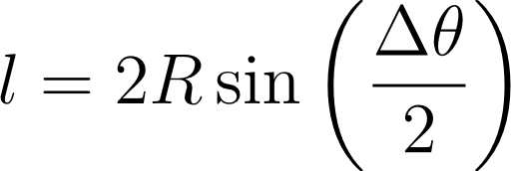
Initializing a ‘softBall’ object:
To the following parameters are passed to softBall constructor to initialize the spring mass arrangement:
Number of surface nodes,
Radius
Coordinates of the center
Springs connections to 0-th node in a six-node soft ball
N = 6
The distance between each node pair (i.e. the equilibrium spring lengths are calculated from the initialized coordinates of surface nodes, trigonometry and geometry of a circle.
The coordinates of each node are calculated using parametric equations of circle:
N = 10

Slide 9
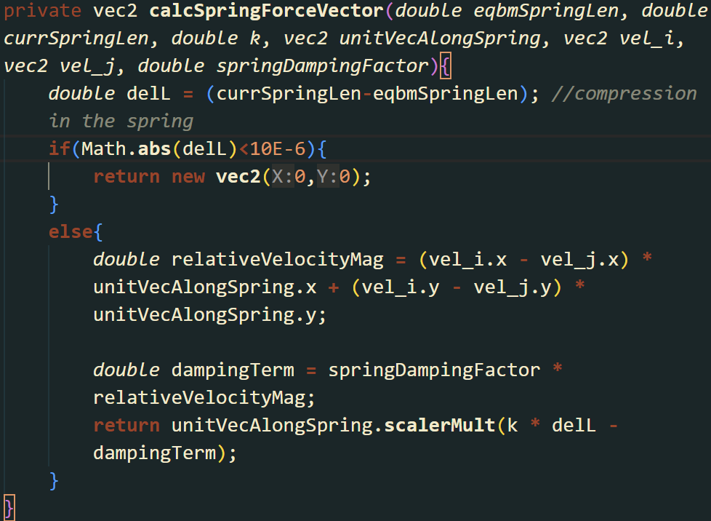
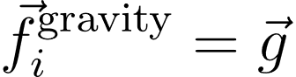
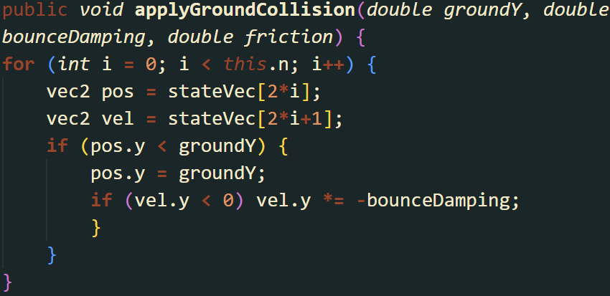
Forces and constraints on the system
Spring force on i-th node:
Gravity:
Ground collision:

Slide 10
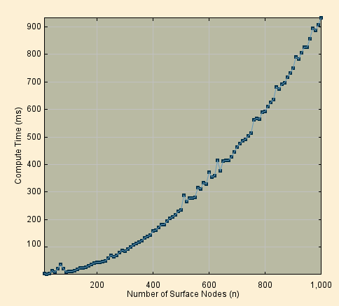
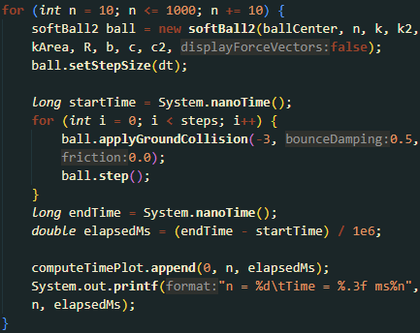
Analysis: Compute speed with number of nodes
(steps = 100)
Non linear scaling, most likely due to a large number of inner spring calculations.

Slide 11
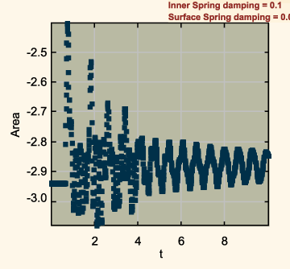
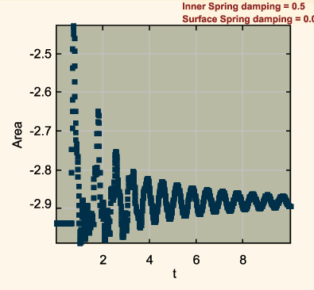
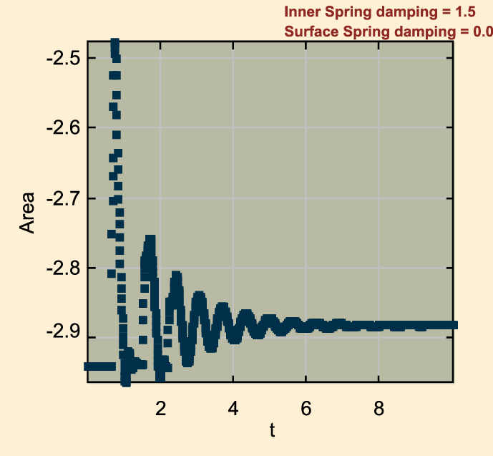
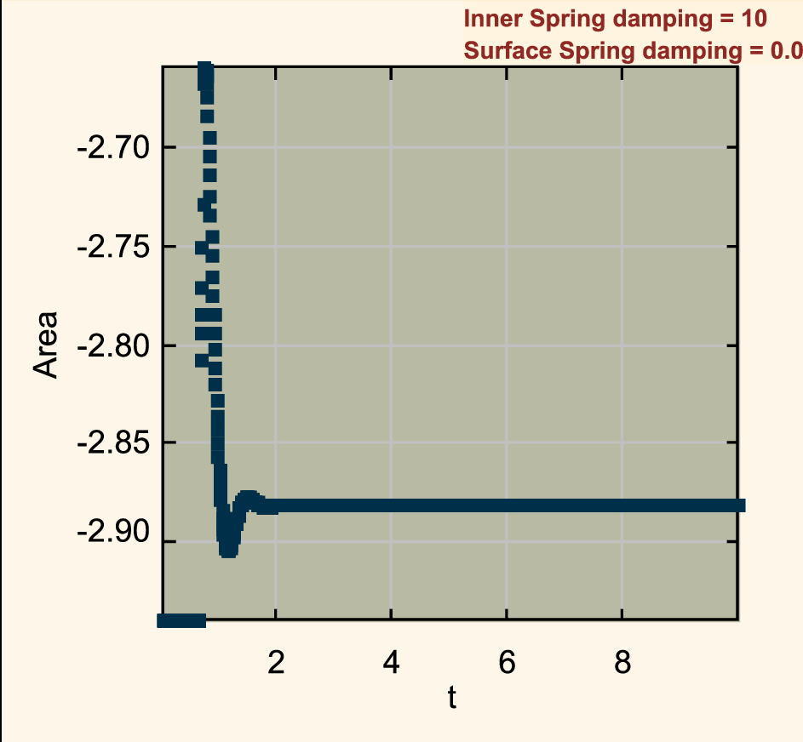
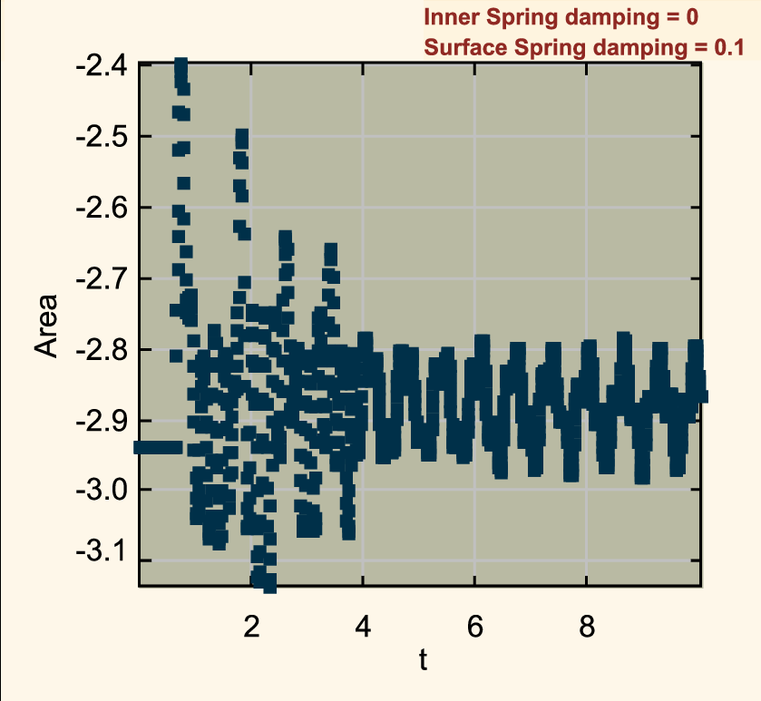
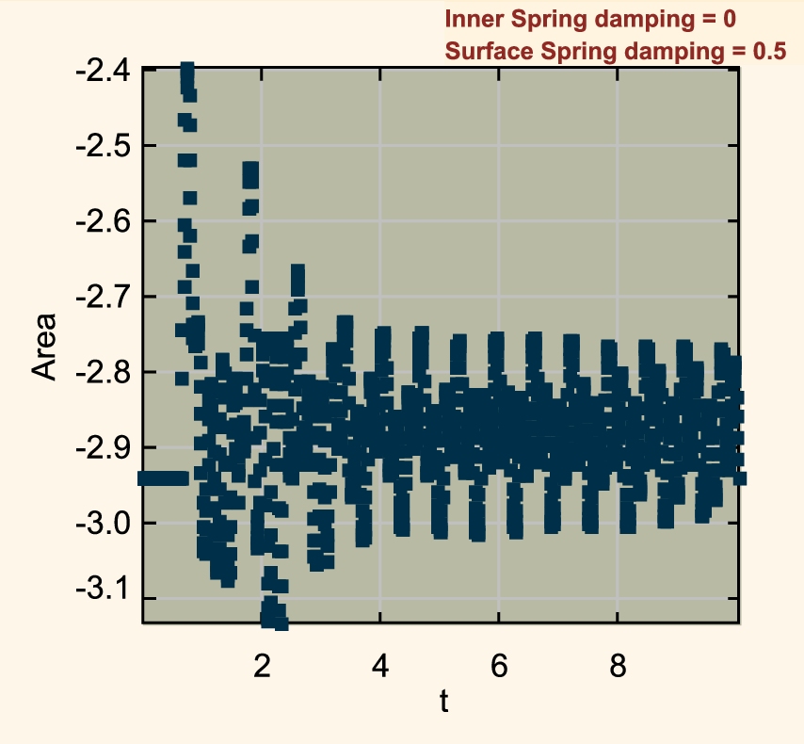
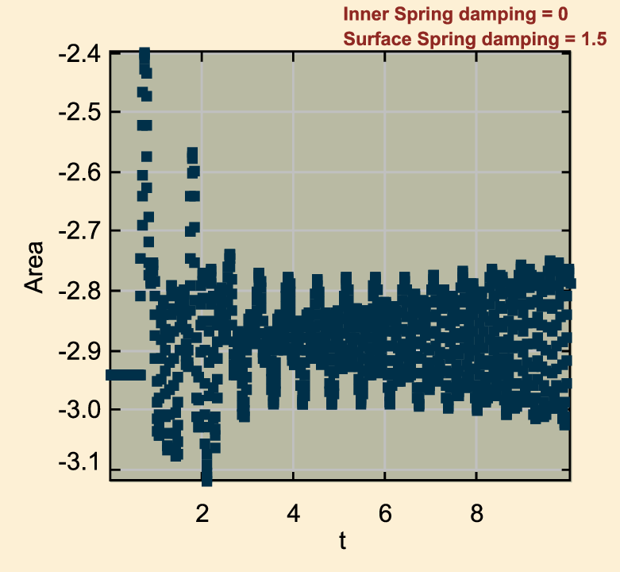
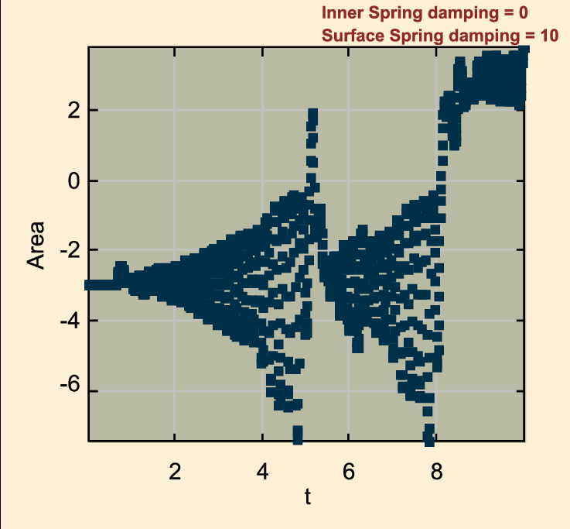
Area vs time for different values of spring damping factors
The collision with the ground are completely inelastic
k = k2 = 100 , n = 10, R = 1, groundY = -3
The fluctuations in area settles down faster as the inner spring damping increases.
The fluctuations in area increases as the surface spring damping increases (even becoming somewhat chaotic at high damping of surface springs!).

Slide 12
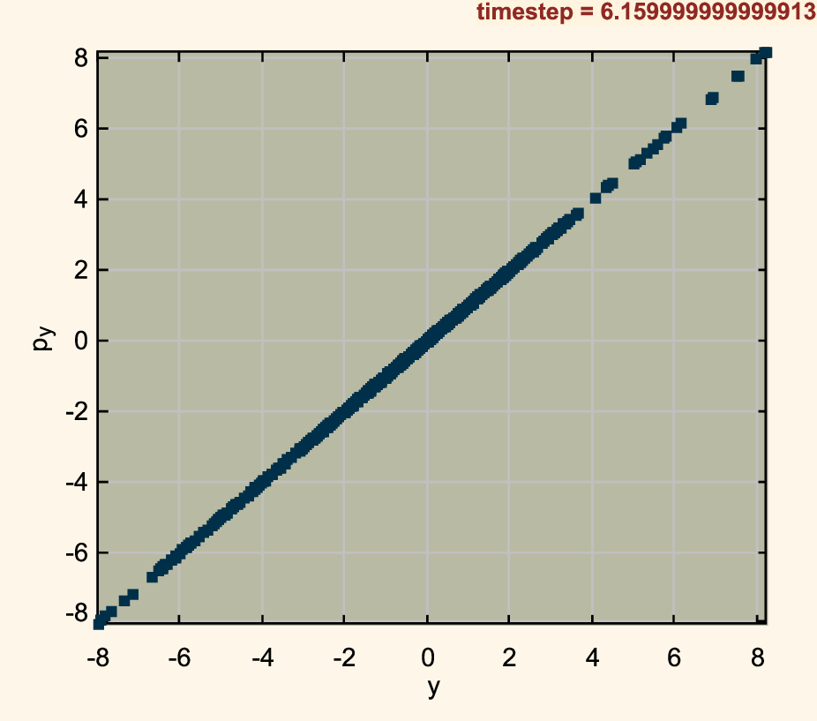
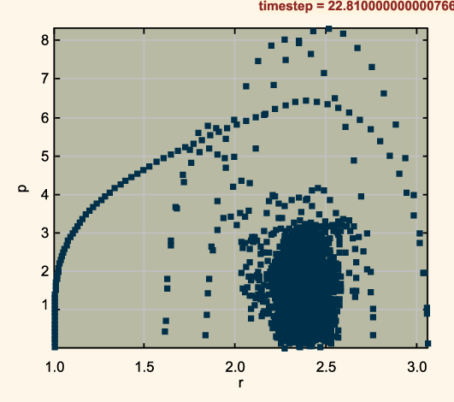
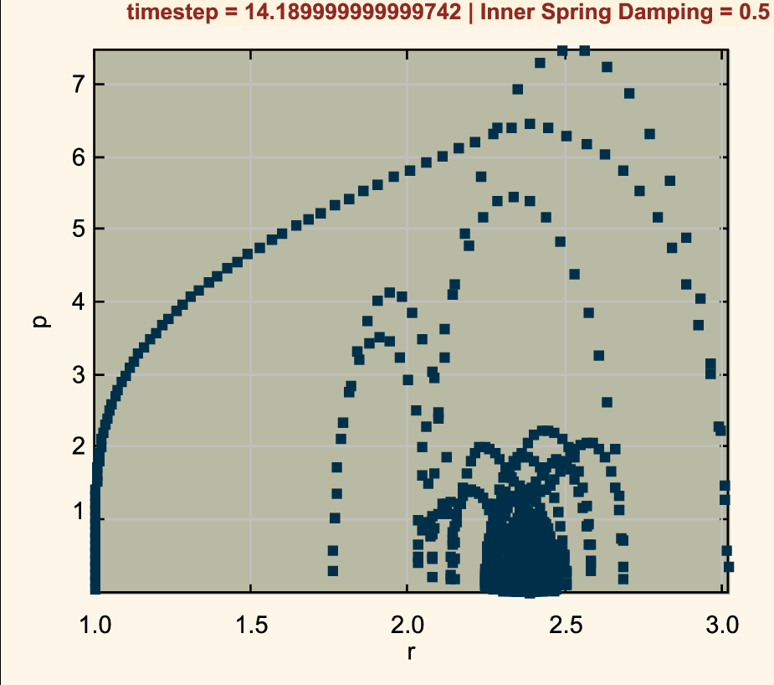
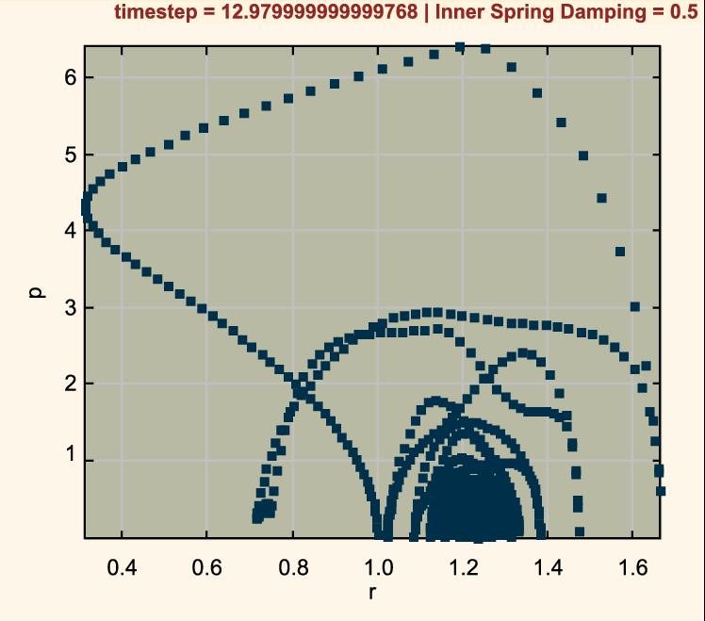
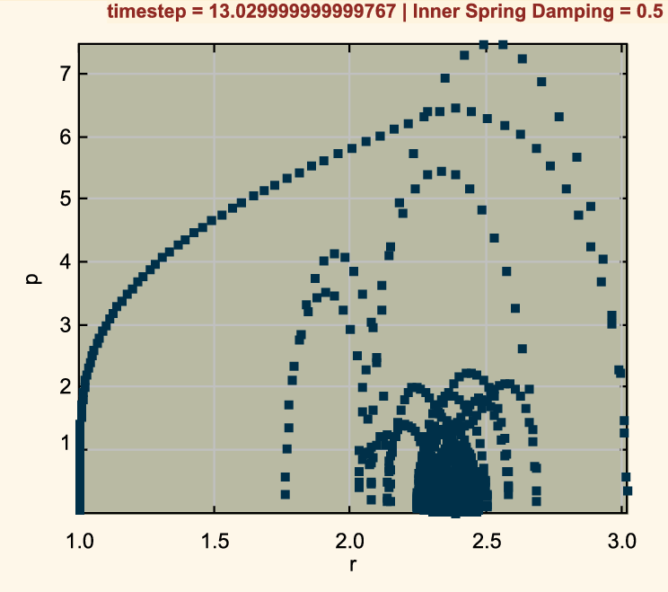
Phase space plots:
Phase space plots for node 0, with no damping
The collision with the ground are completely inelastic
k = k2 = 100 , n = 10, R = 1, groundY = -3
This analysis is not complete yet.
To do:
Phase plots of damped surface springs only
Phase plots of x components
Phase plot of center of mass
y component plot stays linear even after ground collision (not sure about this, need to verify)
Total momentum plot has stability after ground collision
Phase space plots with damping for different nodes
Total momentum plots for all the nodes seem to be stable after ground collision
This makes sense because the collision with ground is inelastic, which is captured by the large spread of phases space during ground collision.
node 0 (on the right)
node 3 (closest to ground)
node 5 (furthest from ground)

Slide 13
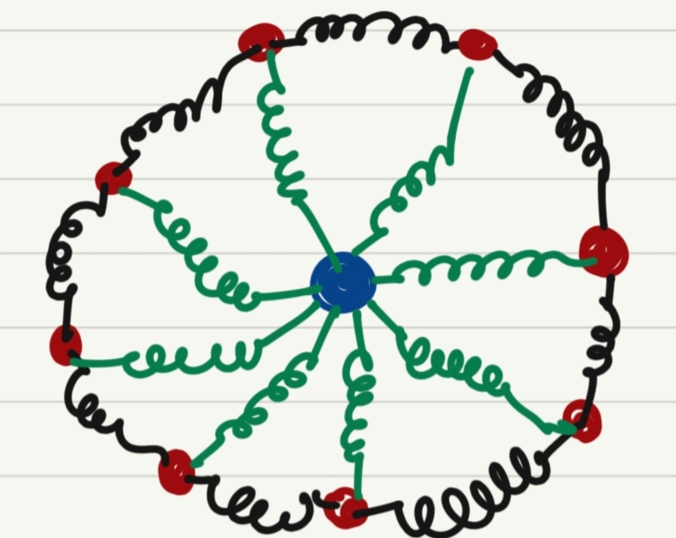
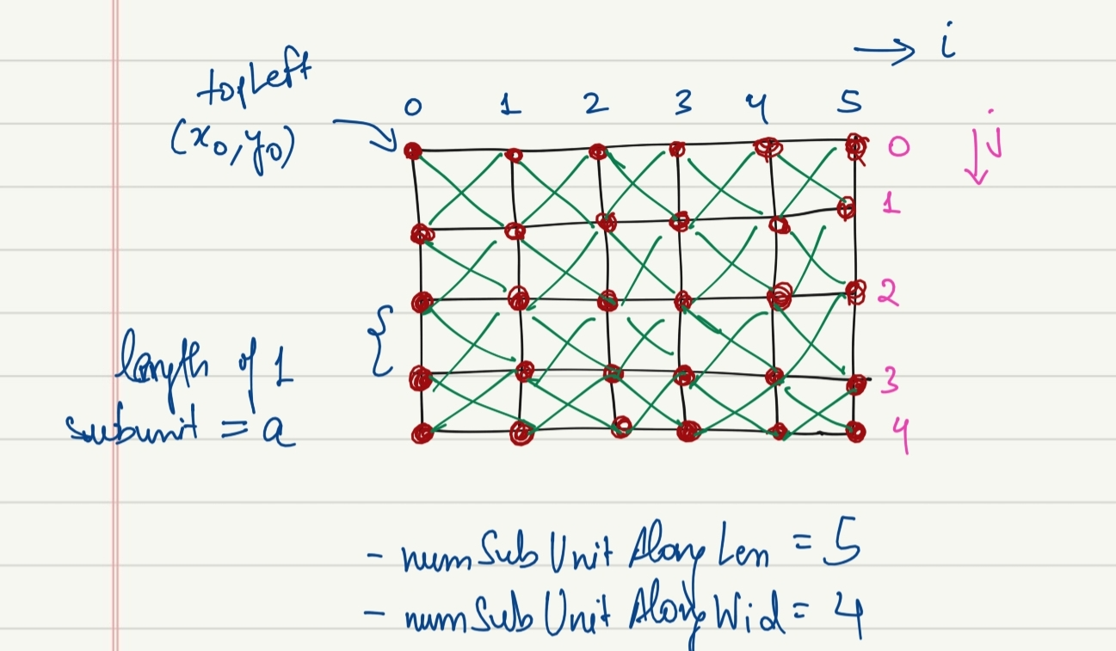
Stuff that I tried but didn’t work…..
A soft body with a node at center connected to surface nodes with springs
..…or haven’t had time to implement yet (future goals)
Rigid body bounce and comparison with soft body bounce by calculating the time of contact with ground for each.
Collision with rigid bodies and other soft bodies.
Other arrangements of spring mass nodes for rigid bodies, for example a rectangular soft body.

Slide 14
Thank you for listening!

